Slide 1
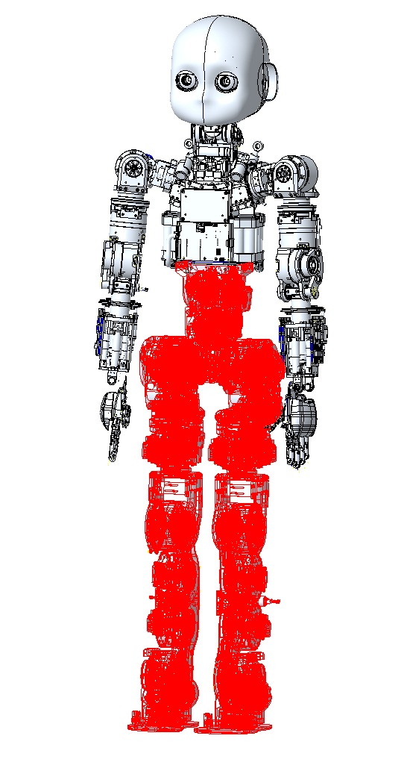
iCub3 Lowerbody joints’ specs
Rev. 0
18/01/2018
Marcello Savoldi

Slide 2
Motor management
576
576
576
576
575
576
575
Motor Type 576 | MOOG_C2900576 Moog BLDC motor, OD 49.2, ID 15.5, L 24.7 , W/O HALL SENSOR
Motor Type 580 | MOOG_C2900580 Moog BLDC motor, OD 72.4, ID 15.5, L 27.5 , W/O HALL SENSOR
Motor Type 575 | MOOG_C2900575 Moog BLDC motor, OD 49.2, ID 15.5, L 17.7 , W/O HALL SENSOR
576
575
575
576
580
580
576
576
576
576
580
580
580
580
575
575

Slide 3
Joint ref. number
J-02
J-01
J-03
J-00
J-04
J-05
J-06
Joint-07 = Joint-13
Joint-08 = Joint-14
Joint-09 = Joint-15
Joint-10 = Joint-16
Joint-11 = Joint-17
Joint-12 = Joint-18
J-13
J-07
J-14
J-08
J-15
J-09
J-16
J-10
J-17
J-11
J-18
J-12

Slide 4
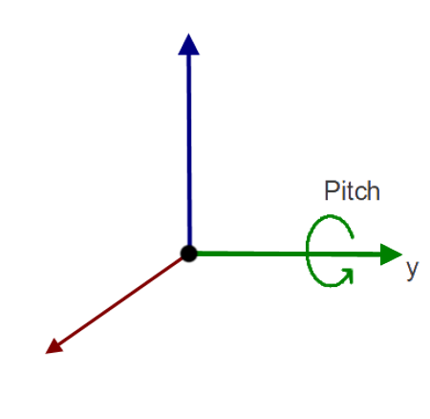
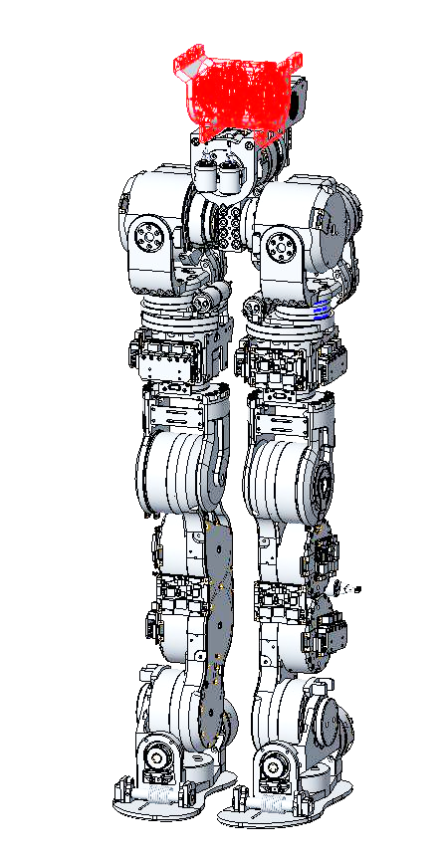
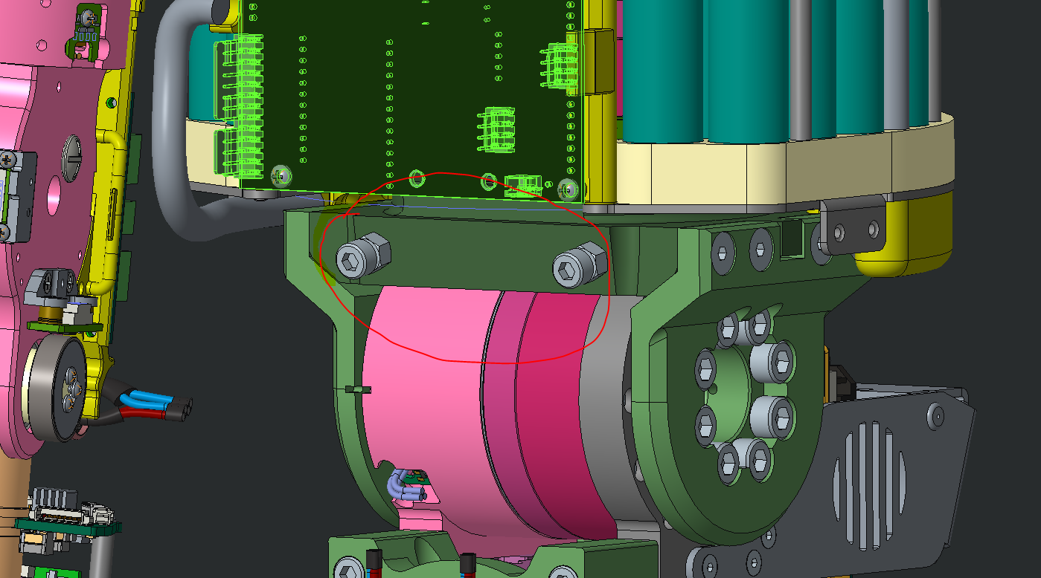
JOINT 05 – Waist Pitch
Motor Type | MOOG_C2900576 Moog BLDC motor, OD 49.2, ID 15.5, L 24.7 , W/O HALL SENSOR
Speed shaft Sensor | Lcore 5 – optical disk 004
slow shaft Sensor | AMO board - magnetic Encoder (103839)
Harmonic Drive | CSD-20-100-2UH_CS (1:100)
HW Limit | +65° (front)* | -25° (rear)
Software Limit
*Note:
Cambiato range motion da 80° a 65° inserendo due viti come hard stop sul waist per
problemi di collisione con la
batteria.
Verificare la presenza delle
Viti.

Slide 5
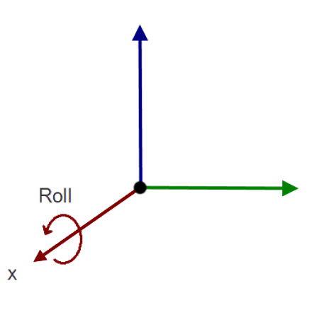
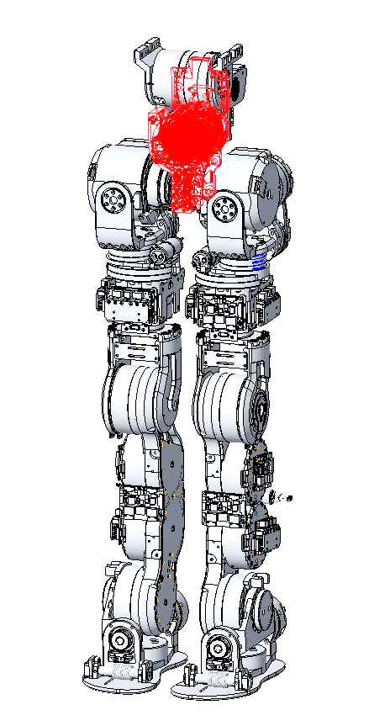
JOINT 06 – Waist Roll
Motor Type | MOOG_C2900576 Moog BLDC motor, OD 49.2, ID 15.5, L 24.7 , W/O HALL SENSOR
Speed shaft Sensor | Lcore 5 – optical disk 004
slow shaft Sensor | AMO board - magnetic Encoder (103839)
Harmonic Drive | CSD-20-100-2UH_CS (1:100)
HW Limit | +25° | -25°
Software Limit
Note:

Slide 6
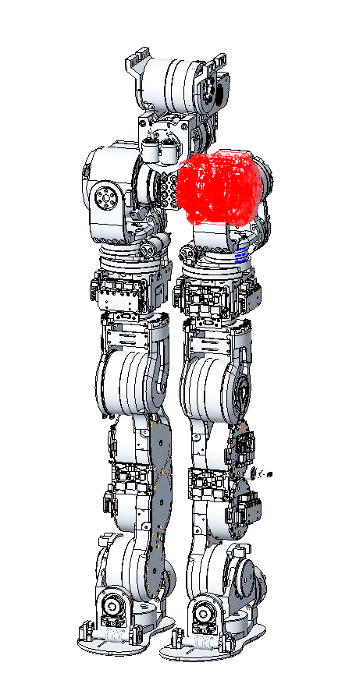
JOINT 07 – left hip Pitch
Motor Type | MOOG_C2900580 Moog BLDC motor, OD 72.4, ID 15.5, L 27.5 , W/O HALL SENSOR
Speed shaft Sensor | Lcore 5 – optical disk 004
slow shaft Sensor | AMO board - magnetic Encoder (103839)
Harmonic Drive | CSD-25-100-2UH_CS (1:100)
HW Limit | +130° (front) * | -45° (rear)
Software Limit | +125° (proposal) | -40° (proposal)
*Note:
Sono da rivedere i limiti hardware (hard-stop critico)
Ipotizzare i limiti hardware +120° - 45° e inserire limiti software minori di almeno 5°.

Slide 7
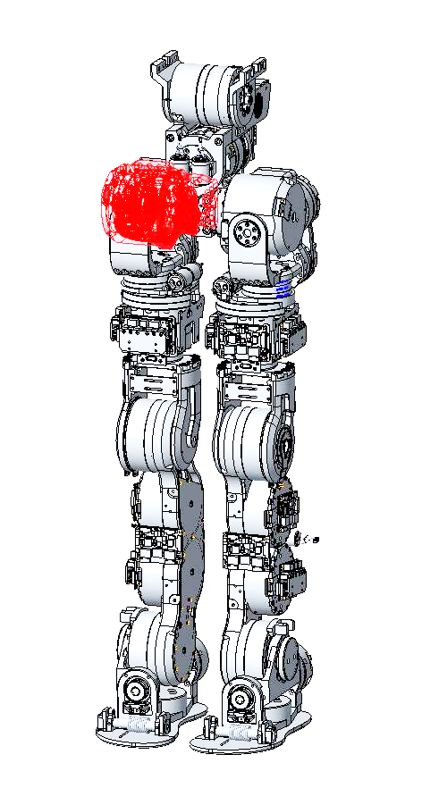
JOINTS 13 – Right hip Pitch
Motor Type | MOOG_C2900580 Moog BLDC motor, OD 72.4, ID 15.5, L 27.5 , W/O HALL SENSOR
Speed shaft Sensor | Lcore 5 – optical disk 004
slow shaft Sensor | AMO board - magnetic Encoder (103839)
Harmonic Drive | CSD-25-100-2UH_CS (1:100)
HW Limit | +130° (front) * | -45° (rear)
Software Limit | +125° (proposal) | -40° (proposal)
*Note:
Sono da rivedere i limiti hardware (hard-stop critico)
Ipotizzare i limiti hardware +120° - 45° e inserire limiti software minori di almeno 5°.

Slide 8
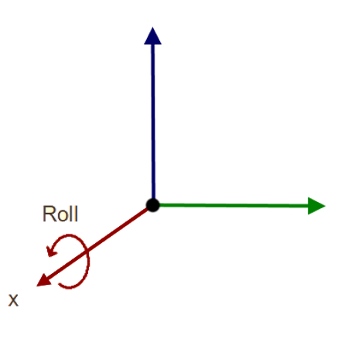
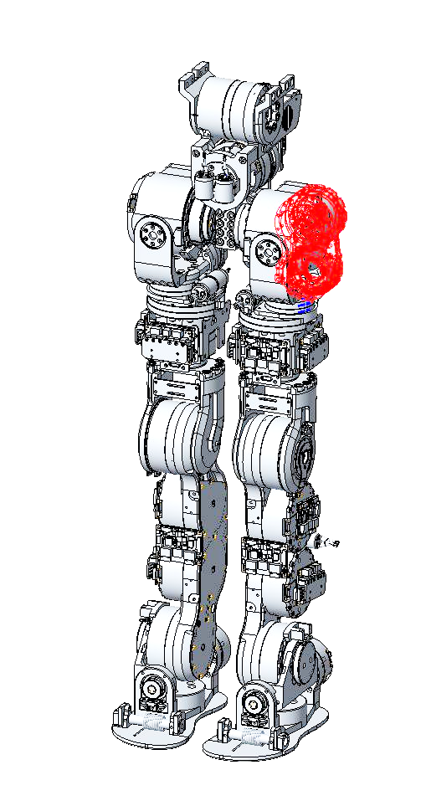
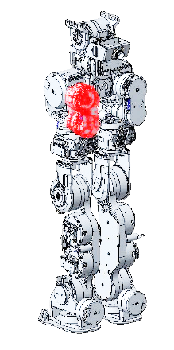
JOINT 08 – left hip Roll
Motor Type | MOOG_C2900576 Moog BLDC motor, OD 49.2, ID 15.5, L 24.7 , W/O HALL SENSOR
Speed shaft Sensor | Lcore 5 – optical disk 004
slow shaft Sensor | AMO board - magnetic Encoder (103839)
Harmonic Drive | CSD-20-100-2UH_CS (1:100)
HW Limit | -116° (external) | +20° (internal)*
Software Limit
*Note:
Attenzione al movimento verso l’interno, che può avvenire solo se l'altra gamba è sollevata ( devono viaggiare minimo paralleli); ossia
Left Hip Roll = +20° solo se Right Hip Roll oltre i -20°

Slide 9
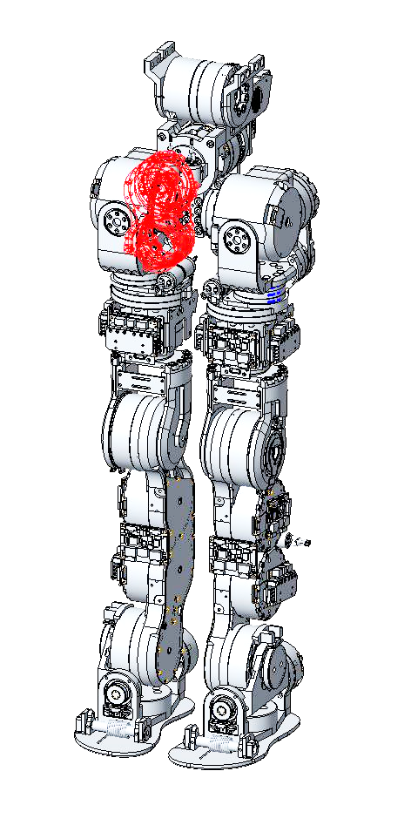
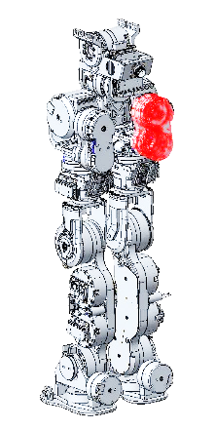
JOINTS 14 – Right hip Roll
Motor Type | MOOG_C2900576 Moog BLDC motor, OD 49.2, ID 15.5, L 24.7 , W/O HALL SENSOR
Speed shaft Sensor | Lcore 5 – optical disk 004
slow shaft Sensor | AMO board - magnetic Encoder (103839)
Harmonic Drive | CSD-20-100-2UH_CS (1:100)
HW Limit | -116° (external) | +20° (internal)*
Software Limit
*Note:
Attenzione al movimento verso l’interno, che può avvenire solo se l'altra gamba è sollevata ( devono viaggiare minimo paralleli); ossia
Right Hip Roll = +20° solo se Left Hip Roll oltre i -20°

Slide 10
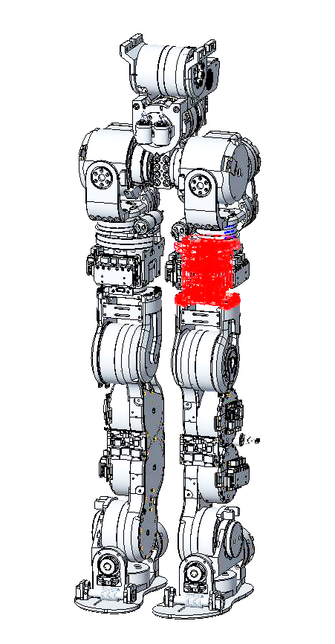
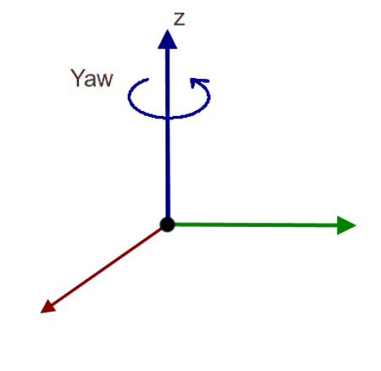
JOINT 09 – left Yaw Leg
Motor Type | MOOG_C2900576 Moog BLDC motor, OD 49.2, ID 15.5, L 24.7 , W/O HALL SENSOR
Speed shaft Sensor | Lcore 5 – optical disk 004
slow shaft Sensor | AMO board - magnetic Encoder (103839)
Harmonic Drive | CSD-20-100-2UH_CS (1:100)
HW Limit | -67.5° | +67.5°
Software Limit
Note:

Slide 11
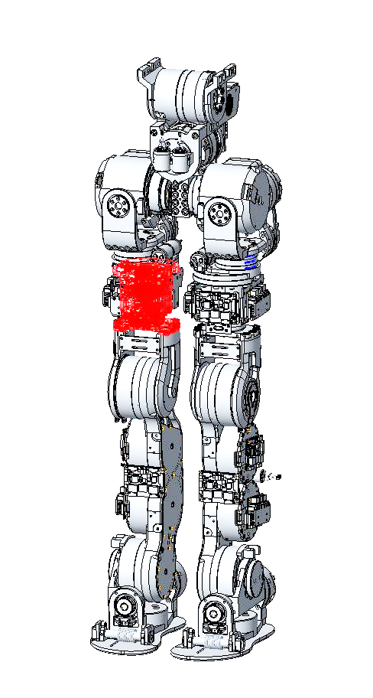
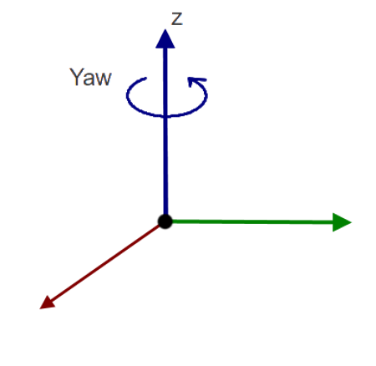
JOINT 15 – Right Yaw Leg
Motor Type | MOOG_C2900576 Moog BLDC motor, OD 49.2, ID 15.5, L 24.7 , W/O HALL SENSOR
Speed shaft Sensor | Lcore 5 – optical disk 004
slow shaft Sensor | AMO board - magnetic Encoder (103839)
Harmonic Drive | CSD-20-100-2UH_CS (1:100)
HW Limit | -67.5° | +67.5°
Software Limit
Note:

Slide 12
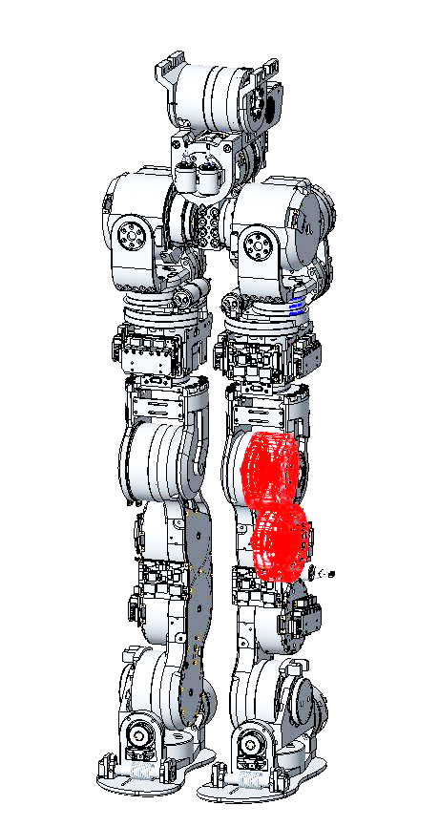
JOINT 10 – Left Knee
Motor Type | MOOG_C2900580 Moog BLDC motor, OD 72.4, ID 15.5, L 27.5 , W/O HALL SENSOR
Speed shaft Sensor | Lcore 5 – optical disk 004
slow shaft Sensor | AMO board - magnetic Encoder (103839)
Harmonic Drive | CSD-25-100-2UH_CS (1:100)
HW Limit | +105° | -5°
Software Limit
Note:

Slide 13
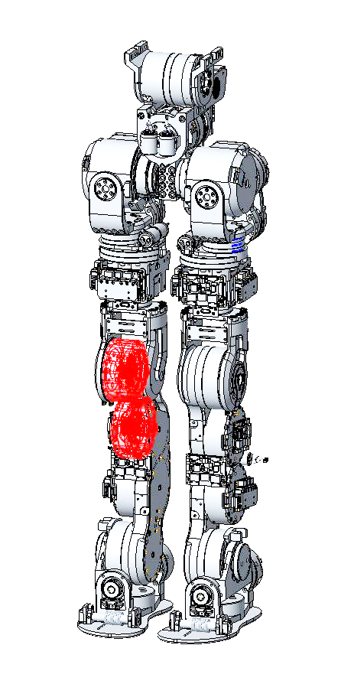
JOINT 16 – Right Knee
Motor Type | MOOG_C2900580 Moog BLDC motor, OD 72.4, ID 15.5, L 27.5 , W/O HALL SENSOR
Speed shaft Sensor | Lcore 5 – optical disk 004
slow shaft Sensor | AMO board - magnetic Encoder (103839)
Harmonic Drive | CSD-25-100-2UH_CS (1:100)
HW Limit | +105° | -5°
Software Limit
Note:

Slide 14
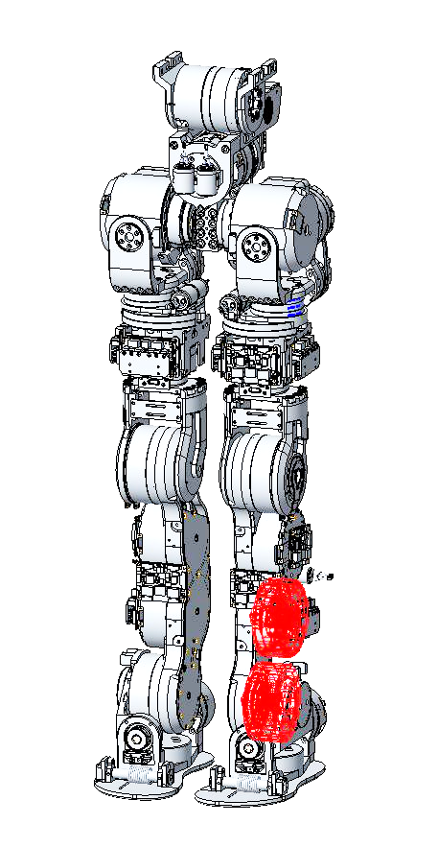
JOINT 11 – Left Pitch foot
Motor Type | MOOG_C2900580 Moog BLDC motor, OD 72.4, ID 15.5, L 27.5 , W/O HALL SENSOR
Speed shaft Sensor | Lcore 5 – optical disk 004
slow shaft Sensor | AMO board - magnetic Encoder (103839)
Harmonic Drive | CSD-25-100-2UH_CS (1:100)
HW Limit | +45° | -45°
Software Limit
Note:

Slide 15
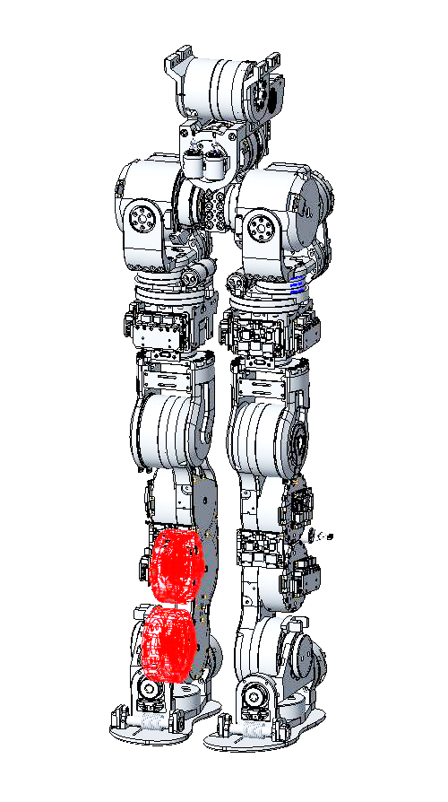
JOINT 17 – Right Pitch foot
Motor Type | MOOG_C2900580 Moog BLDC motor, OD 72.4, ID 15.5, L 27.5 , W/O HALL SENSOR
Speed shaft Sensor | Lcore 5 – optical disk 004
slow shaft Sensor | AMO board - magnetic Encoder (103839)
Harmonic Drive | CSD-25-100-2UH_CS (1:100)
HW Limit | +45° | -45°
Software Limit
Note:

Slide 16
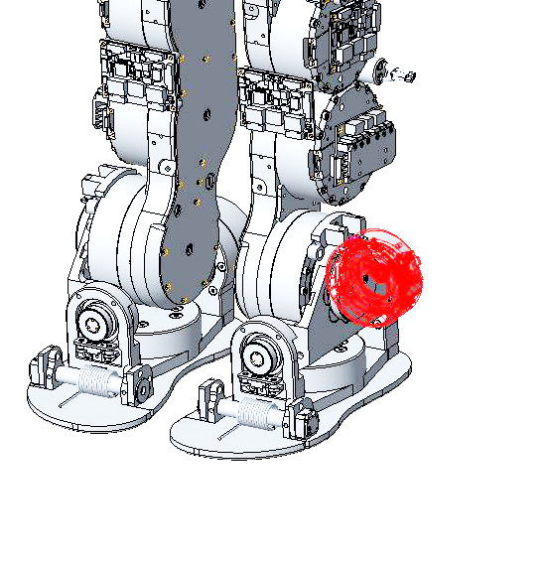
JOINT 12 – Left Roll foot
Motor Type | MOOG_C2900575 Moog BLDC motor, OD 49.2, ID 15.5, L 17.7 , W/O HALL SENSOR
Speed shaft Sensor | Lcore 5 – optical disk 004
slow shaft Sensor | AMO board - magnetic Encoder (1MU7S_25-32N)
Harmonic Drive | CSD-17-160-2A_FS (1:160)
HW Limit | +25° | -25°
Software Limit
Note:

Slide 17
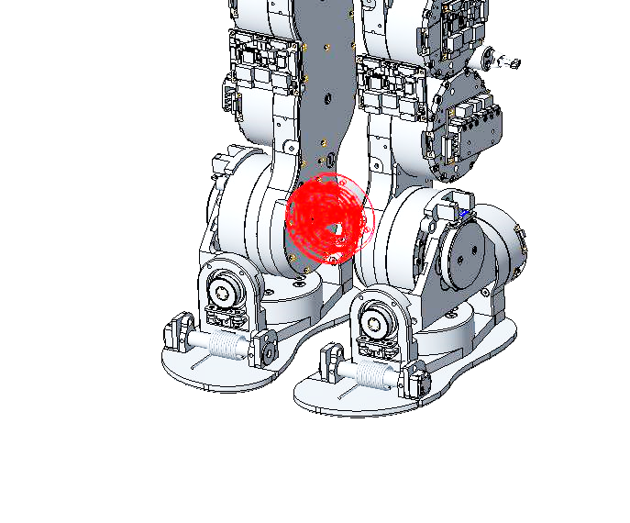
JOINT 18 – Right Roll foot
Motor Type | MOOG_C2900575 Moog BLDC motor, OD 49.2, ID 15.5, L 17.7 , W/O HALL SENSOR
Speed shaft Sensor | Lcore 5 – optical disk 004
slow shaft Sensor | AMO board - magnetic Encoder (1MU7S_25-32N)
Harmonic Drive | CSD-17-160-2A_FS (1:160)
HW Limit | +25° | -25°
Software Limit
Note:

Slide 18
END

